Slide 1
Unlocking the Secret to High Traffic Recipes
Vinayaka G N

Slide 2
Identifying the Challenge
Current recipe selection based on personal preference.
Up to 40% increase in site traffic with popular recipes.
Essential for a data-driven, predictive recipe selection model.

Slide 3
Setting Our Sights
Elevating website traffic via strategic recipe showcasing.
Leveraging data science for 80% accuracy in high-traffic recipe predictions.
Converting enhanced traffic to a surge in subscription rates.

Slide 4
Data Validation
Validated Unique Identifiers: Ensured 'recipe' IDs are distinct across 947 entries, confirming the dataset’s foundational reliability.
Consolidated Category Data: Incorporated 'Chicken Breast' into 'category' for completeness, and standardized 'servings' for consistent numerical analysis.
Maintained Data Completeness: Dropped missing nutritional values post-'high_traffic' binary conversion to preserve data integrity.
Clear Traffic Indicators: Converted 'high_traffic' to a binary variable, marking high popularity as 'True' for direct applicability in models.

Slide 5
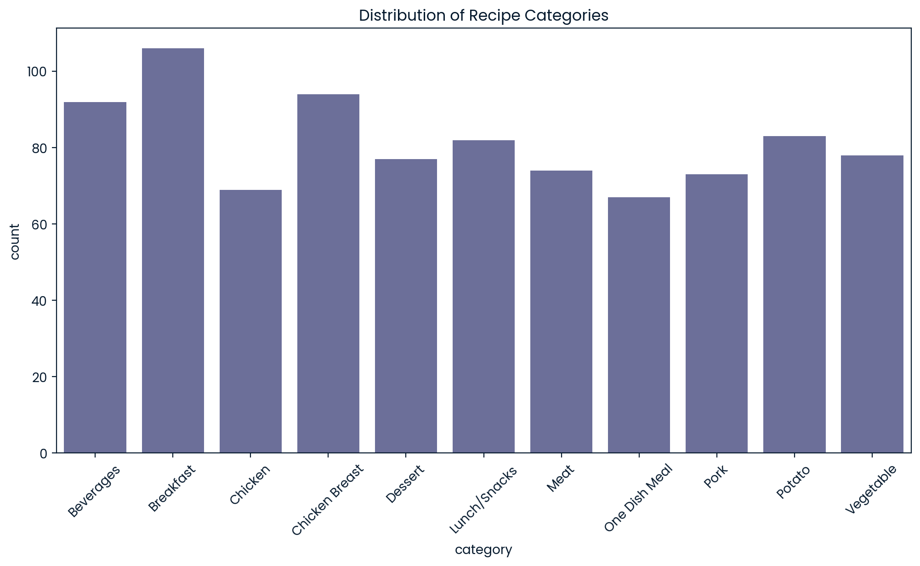
Data Analysis
Bar chart displaying the distribution across different recipe categories.
Identification of the most frequently posted recipe types.
Spotlight on the least common categories featured on the site.

Slide 6
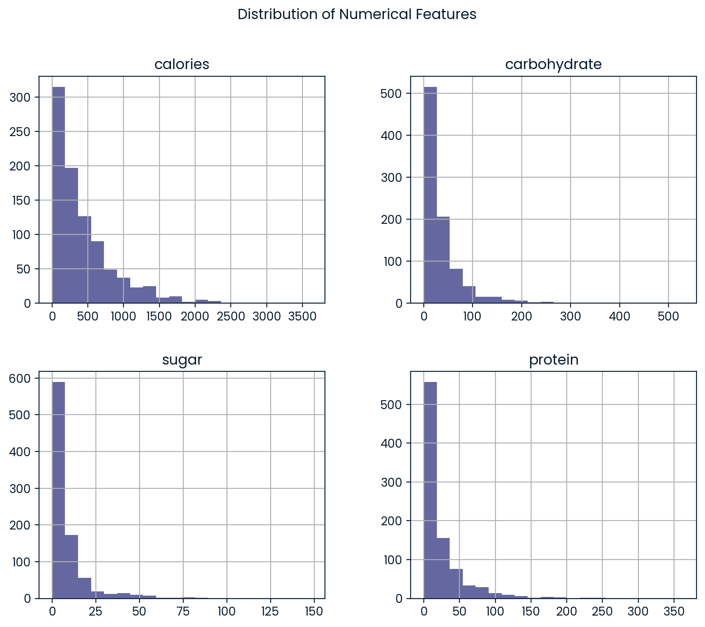
Data Analysis
Histograms illustrating the distribution of nutritional factors: calories, carbohydrates, sugar, protein, and servings.
Notable skewness in the calorie distribution.
Observations on the distribution patterns of other nutrients.

Slide 7
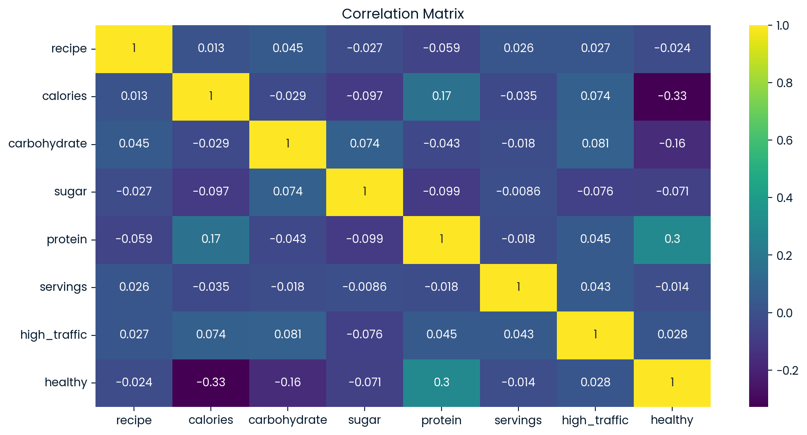
Data Analysis
Correlation matrix indicating the relationship between recipe attributes and site traffic.
Noticeable negative correlation between 'healthy' label and 'calories’.
Mild positive correlation observed between 'protein' and 'high_traffic’.
Absence of strong direct correlations between 'high_traffic' and other individual nutritional factors.

Slide 8
Statistical Significance
Detailed T-test results for calories show a statistically significant difference in mean values between high and low traffic recipes.
For calories: t-statistic of 2.23, p-value of 0.0260.
For protein: t-statistic of 1.33, p-value of 0.1827.
Interpretation of these results informs the impact on traffic.

Slide 9
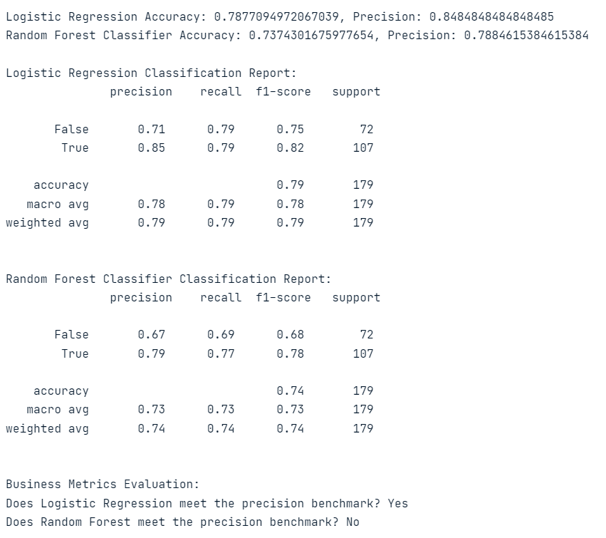
Model Evaluation
Logistic Regression boasts a higher accuracy (0.787) compared to Random Forest (0.737).
Classification reports detail precision, recall, and f1-score for both models.
Logistic Regression shows a balanced performance across different metrics.

Slide 10
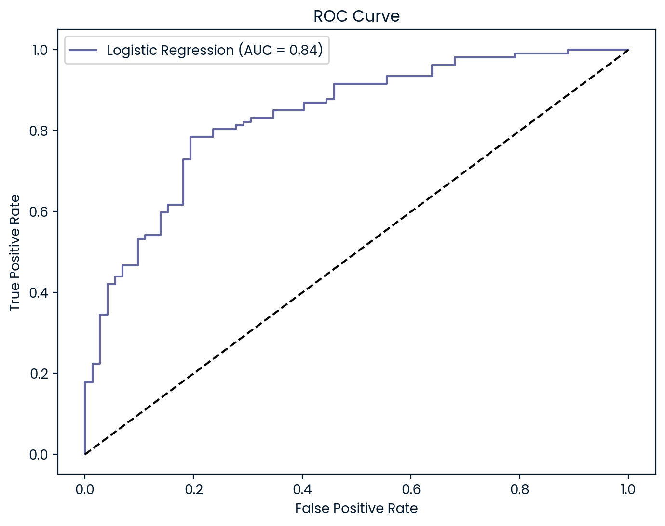
Model Insights
The ROC Curve for Logistic Regression with an AUC of 0.87.
Interpretation of the AUC as a measure of the model's ability to distinguish between classes.

Slide 11
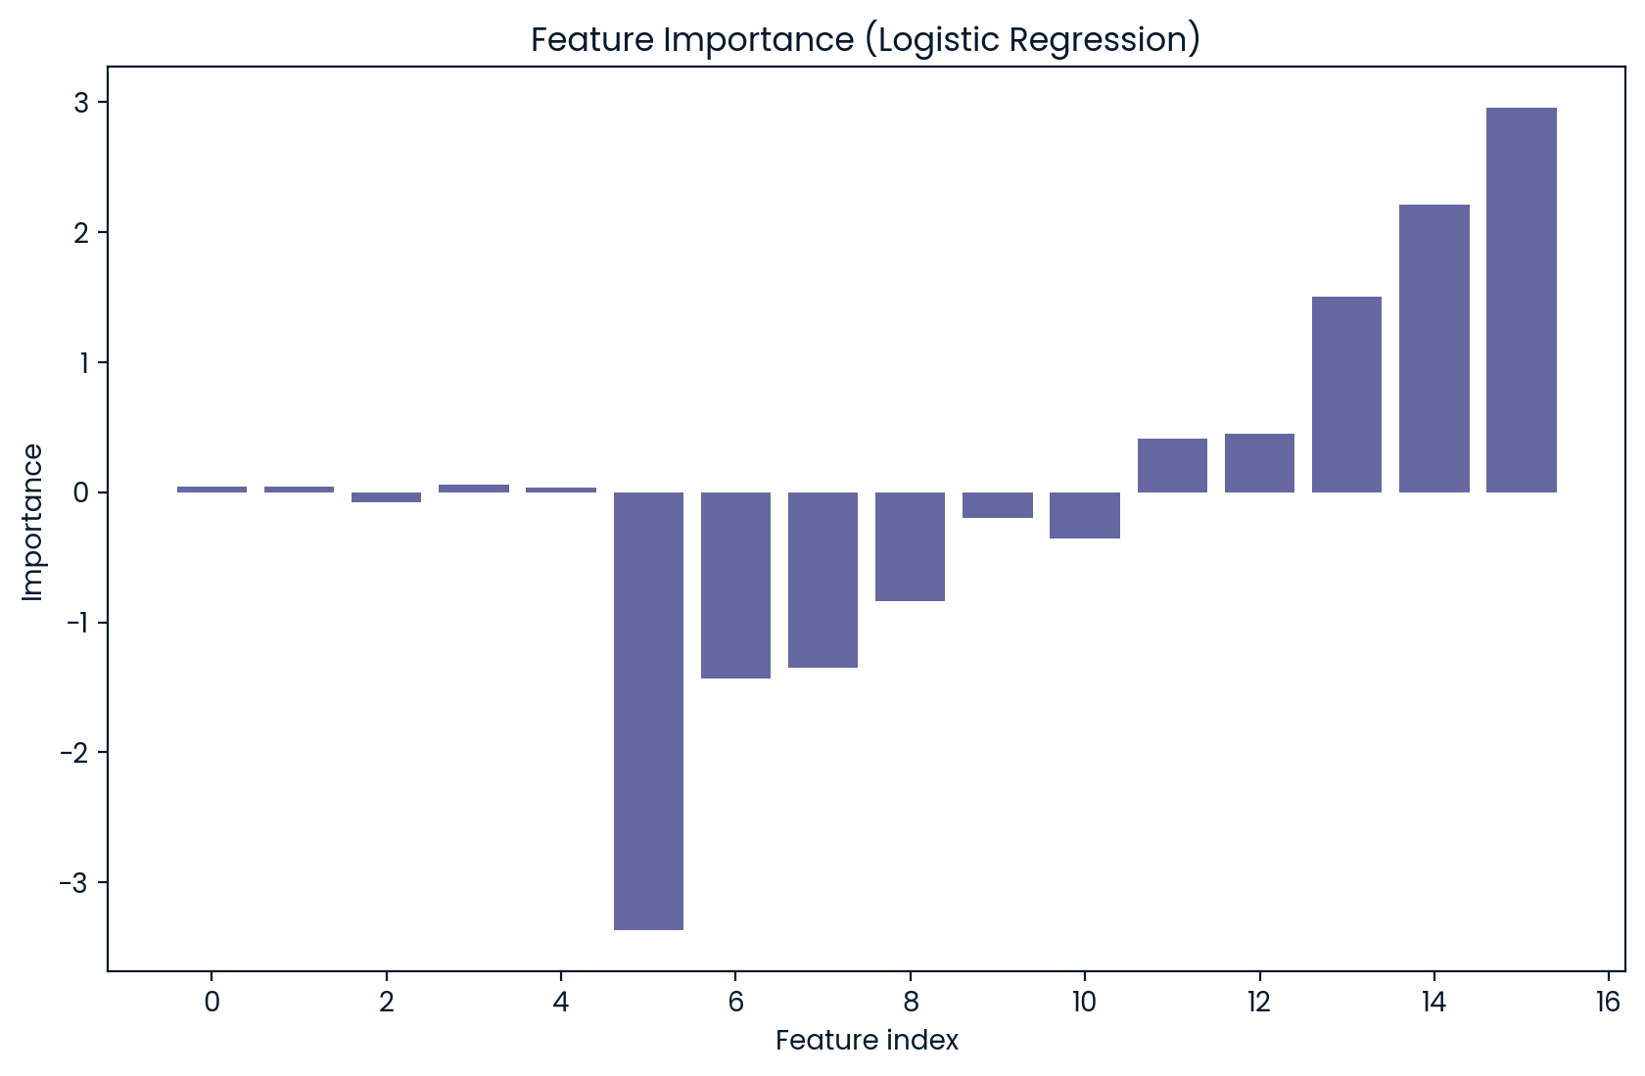
Features That Matter
Bar chart of feature importance from Logistic Regression.
Discussion on the most influential features for predicting high website traffic.

Slide 12
Action Plan for Sustained Growth
Integrate the Logistic Regression model into the recipe selection process.
Monitor model performance and user engagement metrics post-implementation.
Establish a framework for periodic retraining of the model with new data.
Explore the potential for incorporating user feedback and interaction data into the model.

Slide 13
Thank You

